Slide 1
Unit -5
Shading, and Hidden Surfaces
Prepared by
Rutuja A Kulkarni
PICT,Pune

Slide 2
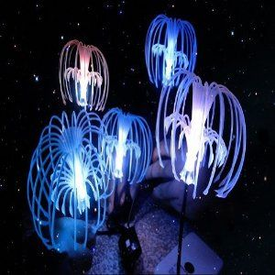

Slide 3


Slide 4
Illumination Model
Realistic displays of a scene are obtained by generating perspective projections of objects and by applying natural lighting effects to the visible surface.
An illumination model, also called a lighting model and sometimes referred to as a shading model is used to calculate the intensity of light that we should see at a given point on the surface of an object.
we will use the term surface rendering to mean a procedure for applying a lighting model to obtain pixel intensities for all the projected surface positions in a scene.

Slide 5
Illumination Model
Lighting effects include
Light reflections
Transparency
Surface texture
Shadows.
Once light reaches our eyes, it triggers perception processes that determine what we actually "see" in a scene.
Objects can be constructed of opaque materials, or they can be more or less transparent.

Slide 6
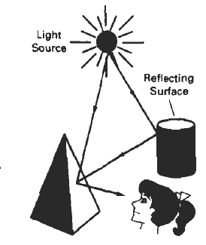
LIGHT SOURCES
When we view an opaque nonluminous object,
we see reflected light from the surfaces of the object.
The total reflected light is the sum of the
contributions from light sources and
other reflecting surfaces in the scene
Thus, a surface that is not directly exposed
to a light source may still be visible if nearby objects are illuminated.
A luminous object, in general, can be both a light source and a light reflector.
E.g.: Lantern

Slide 7
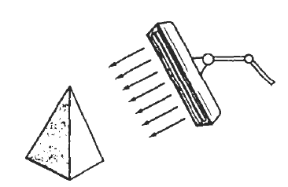
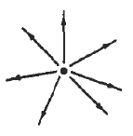
LIGHT SOURCES
We will use the term light source to mean an object that is emitting
radiant energy, such as a Light bulb or the sun.
1. Point Source 2. Distributed light source.
When light is incident on an opaque surface, part of it is reflected and part is absorbed.

Slide 8
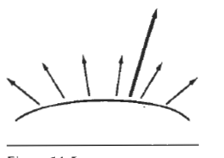
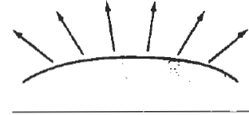
LIGHT SOURCES
Surfaces that are rough, or grainy, tend to scatter the reflected light in all directions. This scattered light is called diffuse reflection.
What we call the color of an object is the color of the diffuse reflection of the incident light.
In addition to diffuse reflection, light sources create highlights, or bright spots, called specular reflection.
1. Diffuse Reflection 2. Specular Reflection

Slide 9

BASIC ILLUMINATION MODELS
Here we discuss simplified methods for calculating light intensities.
Lighting calculations are based on the optical properties of surfaces, the background lighting conditions, and the light-source specifications.
All light sources are considered to be point sources, specified with a coordinate position and an intensity value (color).
Ambient Light:

Slide 10
Cont’d
A surface that is not exposed directly to a light source still will be visible it nearby objects are illuminated.
It is also referred as Background light.
The amount of ambient light incident on each object is a constant for all surfaces and over all directions.
We can set the level for the ambient light in a scene with parameter I_{a} and each surface is then illuminated with this constant value.
The resulting reflected light is a constant for each surface, independent of the viewing direction and the spatial orientation of the surface.

Slide 11
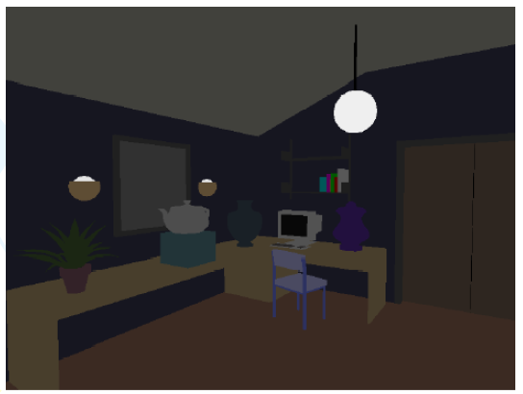
Cont’d
But the intensity of the reflected light for each surface depends on the optical properties of the surface; that is, how much of the incident energy is to be reflected and how much absorbed.
I_{a}K_{a}
–I_{a} = intensity of ambient light
–K_{a}= percentage of the light
reflected by the object

Slide 12
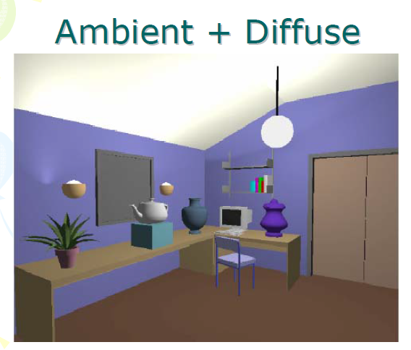
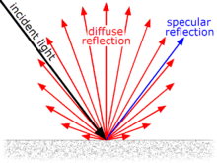
Cont’d
Diffuse Reflection:

Slide 13
Cont’d
Diffuse Reflection: Ambient-light reflection is an approximation of global diffuse lighting effects.
Diffuse reflections are constant over each surface in a scene, independent of the viewing direction.
The fractional amount of the incident light that is diffusely reflected can be set for each surface with parameter K_{d}, the diffuse-reflection coefficient, or diffuse reflectivity.
Parameter K_{d} is assigned a constant value in the interval 0 to 1, according to the reflecting properties we want the surface to have.

Slide 14

Cont’d
Diffuse Reflection: If a surface is exposed only to ambient light, we can express the intensity of the diffuse reflection at any point on the surface as
Lambert's cosine law:
This law states that the radiant energy from any small surface area dA in any direction & relative to the surface normal is proportional to cosɸN

Slide 15
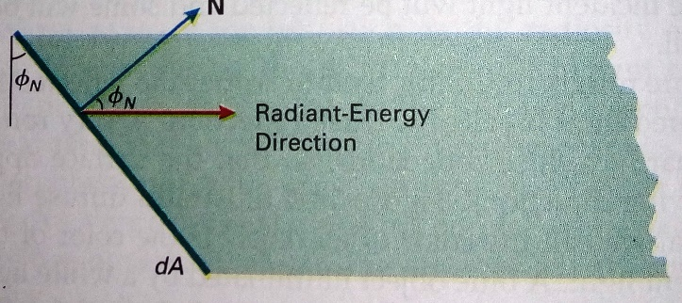

Slide 16
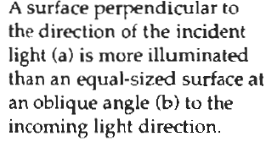
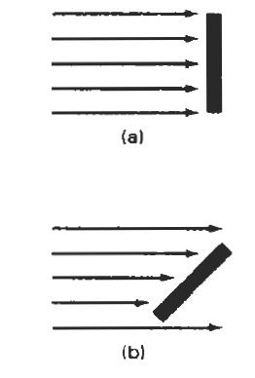
Cont’d
A surface which obeys Lambert's law is said to be Lambertian, and exhibits Lambertian reflectance. Such a surface has the same radiance when viewed from any angle.

Slide 17
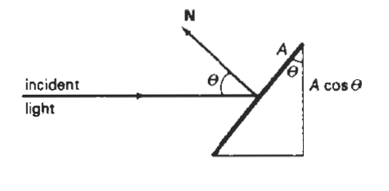

Cont’d
If we denote the angle of incidence between the incoming light direction and the surface normal as θ, then the projected area
of a surface patch perpendicular to the light
direction is proportional to cosθ
I_{l}, is the intensity of the point light source,
then the diffuse reflection equation for a point
on the surface can be written as

Slide 18

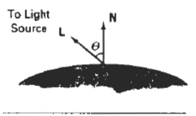

Cont’d
If N is the unit normal vector to a surface and L is the unit direction vector to the point light source from a position on the surface, then cosθ =N.L and the diffuse reflection equation for single point-source illumination is
Above equation is illustrated by following diagram

Slide 19
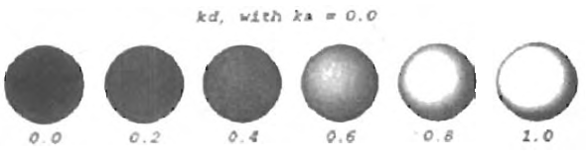


Cont’d
The renderings in this figure illustrate single point-source lighting with no other lighting effects.
Diffuse Reflection:

Slide 20
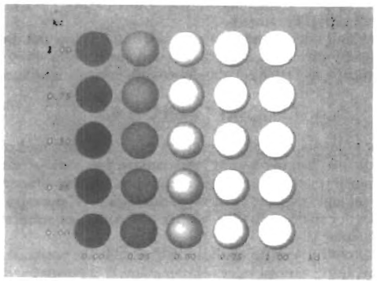

Cont’d
Diffuse Reflection:

Slide 21
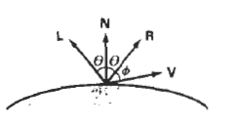
Cont’d
Specular Reflection and the Phong Model:
When we look at an illuminated shiny surface, such as polished metal, an apple, or a person's forehead, we see a highlight, or bright spot, at certain viewing directions. This phenomenon, called specular reflection, is the result of total, or near total, reflection of the incident light in a concentrated region around the specular reflection angle.

Slide 22
The value assigned to specular-reflection parameter ns, is determined by the type of surface that we want to display.
A very shiny surface is modeled with a large value for ns, (say, 100 or more), and smaller values (down to 1) are used for duller surfaces.
For a perfect reflector, ns, is infinite.
For a rough surface, such as chalk or cinderblock, n, would be assigned a value near 1.

Slide 23
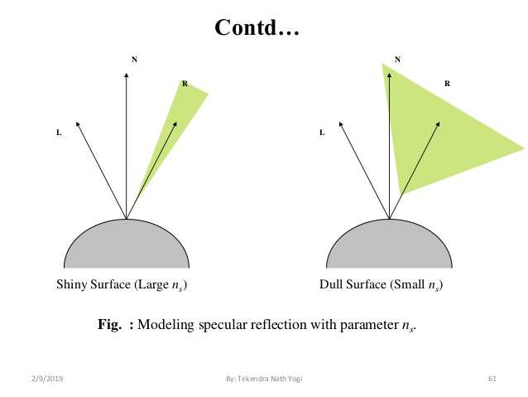

Cont’d
Specular Reflection and the Phong Model:
Phong model, sets the intensity of specular reflection proportional to cos^{ns}ɸ.

Slide 24
Cont’d
The intensity of specular reflection depends on the material properties of the surface and the angle of incidence, as well as other factors such as the color of the incident light.
We can approximately model monochromatic specular intensity variations using a specular-reflection coefficient, W(θ), for each surface.
Figure shows the general variation of W(θ) over the range θ = 0" to θ = 90 degrees for a few materials.
In general, W(θ) tends to increase as the angle of incidence increases.

Slide 25


Cont’d
Phong specular-reflection model is written as:
For many opaque materials, specular reflection is nearly constant for all incidence angles. In this case, we can reasonably model the reflected light effects by replacing W(θ) with a constant specular-reflection coefficient ks.

Slide 26
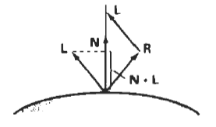
Cont’d
Vector R in this expression can be calculated in terms of vectors L and N. As seen in Fig., the projection of L onto the direction of the normal vector is obtained with the dot product N . L. Therefore, from the diagram, we have
R=N(N.L)+a
And L + a= N(N.L)
So,
R + L = (2N. L)N
And the specular-reflection
vector is obtained as:
R = (2N.L)N – L
a
a

Slide 27


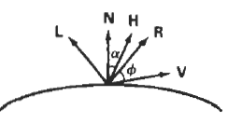
Cont’d
A somewhat simplified Phong model is obtained by using the halfway vector H between L and V to calculate the range of specular reflections. If we replace V.R in the Phong model with the dot product N.H, this simply replaces the empirical cosɸ calculation with the empirical cosα calculation, The halfway vector is obtained as

Slide 28

Combined Diffuse and Specular Reflections with Multiple Light Sources
For a single point light source, we can model the combined diffuse and specular reflections from a point on an illuminated surface as:
If we place more than one point source in a scene, we obtain the light reflection at any surface point by summing the contributions from the individual sources:

Slide 29

Cont’d

Slide 30
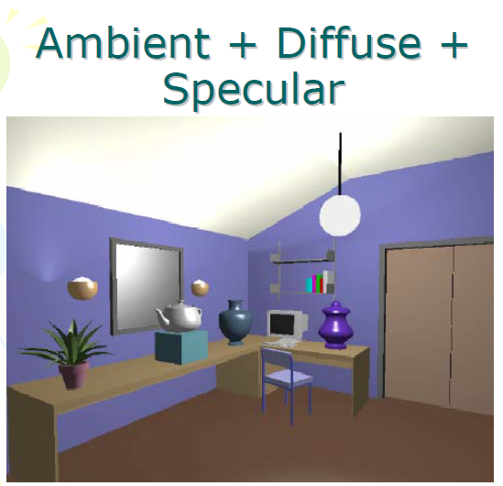
Cont’d

Slide 31
Warn Model
So far we have considered only point light sources. The Warn model provides a method for simulating studio lighting effects by controlling light intensity in different directions.
Light sources are modeled as points on a reflecting surface, using the Phong model for the surface points. Then the intensity in different directions is controlled by selecting values for the Phong exponent. In addition, light controls, such as "barn doors" and spotlighting, used by studio photographers can be simulated in the Warn model.

Slide 32

Cont’d
Flaps are used to control the amount of light emitted by a source In various directions. Two flaps are provided for each of the x, y, and z directions. Spotlights are used to control the amount of light emitted within a cone with apex at a point-source position.

Slide 33
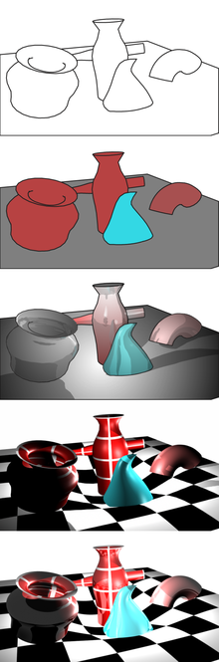
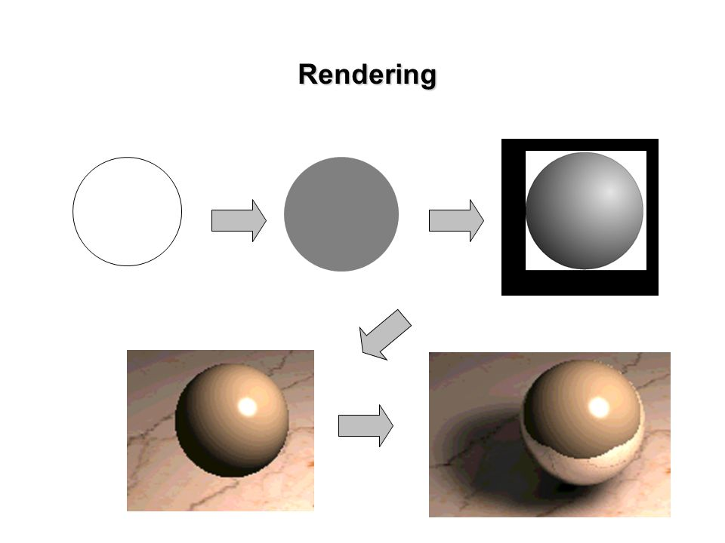

POLYGON-RENDERING METHODS
Each polygon can be rendered with a single intensity, or the intensity can be obtained at each point of the surface using an interpolation scheme.

Slide 34
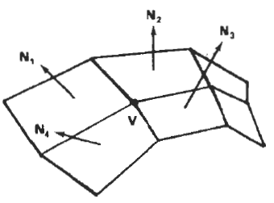

Constant-Intensity Shading
A fast and simple method for rendering an object with polygon surfaces is constant-intensity shading, also called flat shading.
In this method, a single intensity is
calculated for each polygon.
The normal vector at vertex V is
calculated as the average of the
surface normals for each polygon
sharing that vertex.

Slide 35
Gouraud Shading
This inteneity-interpolation scheme, developed by Gouraud and generally referred to as Gouraud shading, renders a polygon surface by linearly interpolating intensity values across the surface.
Intensity values for each polygon are matched with the values of adjacent polygons along the common edges, thus eliminating the intensity discontinuities that can occur in flat shading.
Each polygon surface is rendered with Gouraud shading by performing the following calculations:

Slide 36
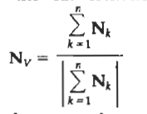
Cont’d
Determine the average unit normal vector at each polygon vertex.
Apply an illumination model to each vertex to calculate the vertex intensity.
Linearly interpolate the vertex intensities over the surface of the polygon.

Slide 37
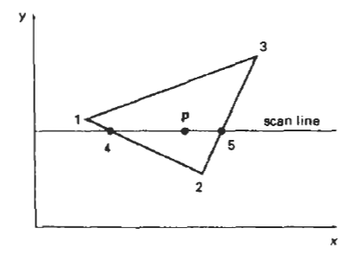
Cont’d
Figure demonstrates the next step: interpolating intensities along the polygon edges.
For each scan line, the intensity at the intersection of the scan line with a polygon edge is linearly interpolated from the intensities at the edge endpoints.
For the example in Fig. the
polygon edge with endpoint
vertices at positions 1 and 2 is
intersected by the scan line at
point 4.

Slide 38


Cont’d
A fast method for obtaining the intensity at point 4 is to interpolate between intensities I1 and I2 using only the vertical displacement of the scan line:
Once these bounding intensities are established for a scan line, an interior point (such as point p in Fig) is interpolated from the bounding intensities at points 4 and 5 as:

Slide 39


Cont’d
Incremental calculations are used to obtain successive edge intensity values between scan lines and to obtain successive intensities along a scan line.
If the intensity at edge position (x, y) is interpolated as
Then we can obtain the intensity along this edge for the next scan line, y-1, as

Slide 40
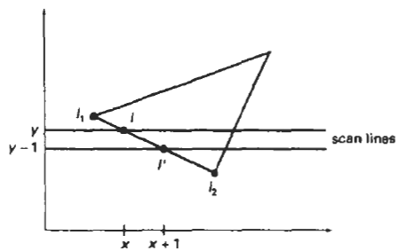
Cont’d
Incremental interpolation of intensity values along a polygon edge for successive scan lines.
Similar calculations are used to obtain intensities at successive horizontal pixel positions along each scan line.

Slide 41
Cont’d
Advantage:
Gouraud shading removes the intensity discontinuities associated with the constant-shading model.
Disadvantages:
Highlights on the surface are sometimes displayed with anomalous shapes, and the linear intensity. Interpolation can cause bright or dark intensity streaks, called Mach bands, to appear on the surface.
These effects can be reduced by dividing the surface into a greater number of polygon faces or by using other methods, such as Phong shading, that require more calculations.

Slide 42
Phong Shading
A more accurate method for rendering a polygon surface is to interpolate normal vectors, and then apply the illumination model to each surface point.
It displays more realistic highlights on a surface and greatly reduces the Mach-band effect.
A polygon surface is rendered using Phong shading by carrying out the following steps:

Slide 43
Cont’d
Determine the average unit normal vector at each polygon vertex.
Linearly interpolate the vertex normals over the surface of the polygon.
Apply an illumination model along each scan line to calculate projected pixel intensities for the surface points.
Interpolation of surface normals along a polygon edge between two vertices is illustrated in Fig.
The normal vector N for the scan-line intersection point along the edge between vertices 1 and 2 can be obtained by vertically interpolating between edge endpoint normals:

Slide 44
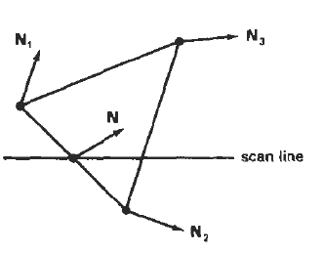

Cont’d
Interpolation of surface normals along polygon edge
Incremental methods are used to evaluate normals between scan lines and along each individual scan line.
At each pixel position along a scan line, the illumination model is applied to determine the surface intensity at that point.

Slide 45
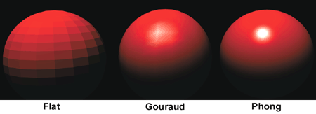
Cont’d
Intensity calculations using an approximated normal vector at each point along the scan line produce more accurate results than the direct interpolation of intensities, as in Gouraud shading.

Slide 46
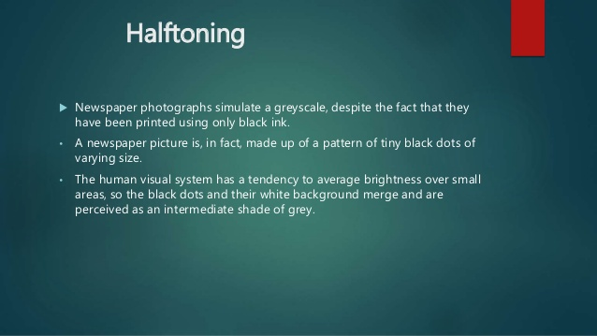
Halftone shading
Continuous-tone photographs are reproduced for publication in news papers, magazines, and books with a printing process called halftoning, and the reproduced picture are called halftones.

Slide 47

Halftone shading

Slide 48
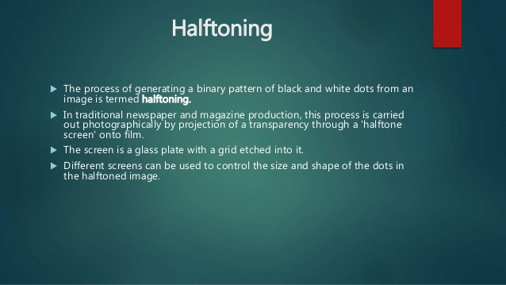
Cont’d

Slide 49
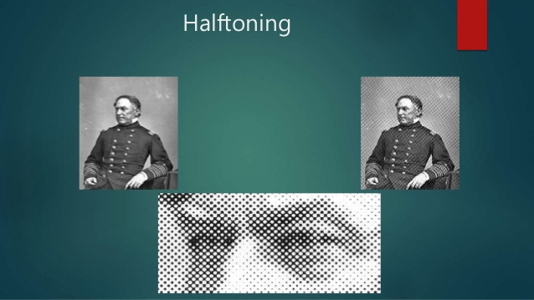
Cont’d

Slide 50
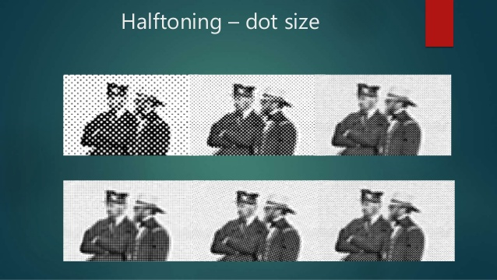

Slide 51
Cont’d
Book and magazine halftones are printed on high quality paper using approximately 60 to 80 circles of varying diameter per centimetre. Newspapers use lower-quality paper and lower resolution (about 25 to 30 ) dots per centimetre.

